Slide 1

ELECTRICAL AND ELECTRONICS ENGINEERING & USER INTERFACE
Wind Speed Prediction using GMDH Neural Networks
Team-9
Team Members
1.Gnanasri – CB.SC.U4AIE24065
2.Rohin Reddy – CB.SC.U4AIE24064
3.Maheswar – CB.SC.U4AIE24058
4.Charith –CB.SC.U4AIE24014

Slide 2
INTRODUCTION
Wind Energy is one of the fastest-growing renewable energy sources globally. Its sustainability, abundance, and eco-friendliness make it a crucial alternative to fossil fuels.
Efficient wind energy utilization requires accurate prediction of wind speed, as it directly affects the performance and reliability of wind turbines.
Accurate wind speed prediction enhances wind power generation efficiency, turbine maintenance planning, and grid stability.
Utilizes historical wind data, weather parameters (temperature, humidity, pressure), and time-based features for better forecasting accuracy.
A web interface will display forecast results for the given data and information about the model and parameters for easy and approachable interpretation.

Slide 3
Wind Speed Prediction Matters :
Ensures grid stability by integrating wind energy reliably
Enhances energy production forecasting for wind farms
Reduces maintenance costs by anticipating wind behavior
Supports sustainable energy planning and decision-making
Group Method of Data Handling (GMDH) is a self-organizing deep learning model known for
Handling non-linear relationships
Providing hi prediction accuracy
Requiring minimal manual tuning
GMDH adapts and evolves its structure, making it ideal for modeling the complex and dynamic nature of wind speed.

Slide 4
LITERATURE REVIEW
S.NO | TITLE | YEAR | METHODOLOGY / TECHNIQUE | KEY CONTRIBUTIONS
1 | Wind Speed Forecasting using GMDH Neural Networks | 2018 | GMDH Neural Networks | Demonstrated superior accuracy in short-term prediction.
2 | Comparison of ANN and GMDH for Wind Forecasting | 2020 | ANN vs GMDH | Showed GMDH outperformed traditional ANN in dynamic wind modeling.
3. | Short-Term Wind Power Prediction using GMDH | 2017 | GMDH + Data preprocessing | Improved prediction accuracy using preprocessed meteorological data.
4 | Hybrid GMDH and GA Approach for Wind Forecasting | 2019 | GMDH + Genetic Algorithm | Enhanced model optimization and convergence rate.
5 | Machine Learning Models for Wind Speed Forecasting | 2021 | SVM, RF, GMDH | Compared multiple ML models; GMDH showed high adaptability.

Slide 5
KEYWORDS
Wind Speed Prediction
GMDH Neural Network
Time Series Forecasting
Machine Learning for Renewable Energy
Optimization in Neural Forecasting
Wind Energy Modeling
Short-Term Forecasting Techniques
GMDH Applications in Energy
Hybrid Forecasting Models

Slide 6
RESEARCH GAPS
1.Limited Use of GMDH in Wind Forecasting
Most studies still focus on traditional models like ANN.
GMDH is underutilized despite its strong self-organizing capabilities.
2.Lack of Hybrid GMDH Approaches
Very few studies combine GMDH with optimization techniques for better accuracy.
Hybrid models remain largely unexplored.
3. Insufficient Real-Time Application
Many models are trained on historical data only.
Real-time forecasting using GMDH is still in early stages.

Slide 7
4.Performance Benchmarking Missing
Few studies compare GMDH directly with modern deep learning models.
No clear benchmarking for wind speed datasets using GMDH.
5.Limited Exploration of Input Features
Many models rely only on basic meteorological inputs (like wind speed & temperature).
There is scope to integrate more features (e.g., air pressure, solar radiation) for higher precision.
6. Lack of Long-Term Forecasting with GMDH
Most studies focus only on short-term wind speed prediction (next few hours or one day). There is a gap in long-term forecasting (several days ahead) using GMDH neural networks.

Slide 8
PROBLEM STATEMENTS
1.Unpredictable Wind Patterns
Wind speed is highly variable and non-linear, making accurate forecasting a challenging task.
Inaccurate predictions leads to :
1.Energy production loss
2.Inefficient turbine operation
3.Power grid instability
2. High Computational Cost of Deep Models
Advanced deep learning models often require high computational power, long training times, and huge datasets.
GMDH uses self-organizing layers, which helps reduce overfitting by selecting only the best neurons.s a lighter, faster alternative that performs well even on smaller datasets.

Slide 9
3.Insufficient Real-Time Forecasting Capabilities
Most wind speed models are offline and not suitable for real-time predictions required by modern wind farms.
GMDH can be implemented for faster, real-time forecasting applications.
4.Limited Feature Exploration
Many models rely on only 1-2 features (e.g., just wind speed), ignoring other important weather factors.
GMDH can handle multi-variable inputs, capturing deeper relationships for better predictions.
5.Overfitting in Traditional Neural Networks
Traditional models often overfit the training data, leading to poor performance on real-world, unseen data.
GMDH uses self-organizing layers, which helps reduce overfitting by selecting only the best neurons.

Slide 10
OBJECTIVES :
1.To develop an efficient wind speed prediction model using GMDH neural networks.
2.To improve the accuracy and reliability of short-term wind speed forecasting.
3.To compare the performance of GMDH with other machine learning models like ANN .
4.To reduce prediction errors by handling the non-linear behavior of wind patterns.
5.To analyze the impact of different meteorological parameters on wind speed prediction.
6.To implement the model using real-world wind speed datasets for practical relevance.
7.To evaluate the model’s performance using standard metrics such as RMSE, MAE, and R².
8.To explore the potential of GMDH in real-time forecasting applications.

Slide 11
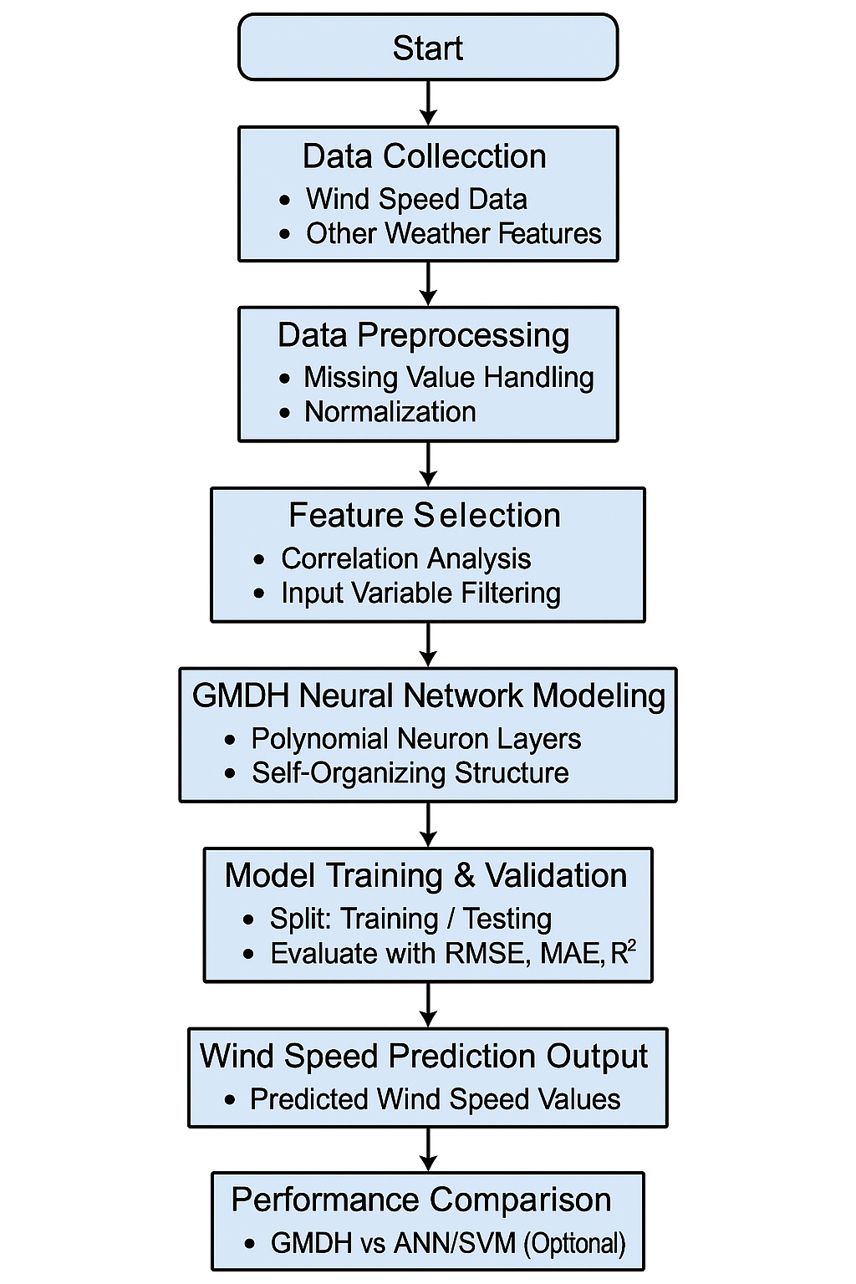
FLOW CHART:

Slide 12
METHODOLOGY
1.Data Collection
Collect real-time or historical wind speed and meteorological data.
Collecting the temperature minimum and temperature maximum.
Collecting Ground temperature and humidity form the Data set.
2.Data Preprocessing
Missing values were identified and replaced using linear interpolation to maintain data continuity.
The dataset was normalized to ensure consistent scaling across features.
Remove outliers for clean input .
3.Feature Selection
Use correlation analysis or statistical methods to select the most relevant input features.
Like selecting the main terms in the dataset.
Reduce dimensionality and improve model performance
Feature selection was performed automatically to identify the most relevant meteorological variables.

Slide 13
4.GMDH Neural Network Modeling
Build the Group Method of Data Handling (GMDH) model
Use polynomial neurons arranged in layers
Let the model self-organize by selecting the best neurons in each layer.
This GMDH model was self-organized sector it will choose the most accurate values.
5. Model Training & Testing
Split dataset into training and testing sets
Training set (80 %) - For model training
Testing set (20 %) - For performance evaluation
Train the GMDH model using the training data ,Validate performance on unseen data.
Use layer-by-layer training to minimize forecasting errors.
6. Prediction & Output Generation
Predict wind speed for future time intervals
Output results as numerical values or graphs
Use metrics such as:
RMSE (Root Mean Square Error)
MAE (Mean Absolute Error)
R² (Coefficient of Determination)

Slide 14
Results and Discussion
1. GMDH Model Accuracy:
Result: GMDH achieved a high R² score on test data.
Inference: Indicates strong predictive power and a good fit between predicted and actual wind speed.
2.Error Metrics:
Result: Low RMSE and MAE values compared to traditional models (e.g., ANN ).
Inference: GMDH provides more accurate and stable predictions.
3. Training Time
Result: GMDH required less training time than deep learning models.
Inference: Suitable for applications with limited computational resources.
4. Feature Selection Impact
Result: Removing weak features improved model performance by ~5-10%.
Inference: Shows the importance of input selection in forecasting models.

Slide 15
5. Real-Time Prediction Capability
Result: GMDH model is able to generate predictions quickly and consistently.
Inference: Makes it practical for real-time wind energy management.
6. Performance Over Different Time Intervals
Result: Accuracy slightly decreases with longer-term forecasts.
Inference: GMDH is more effective for short-term prediction, but can be improved for longer horizons.
7. GMDH Prediction Accuracy
Result: GMDH model achieved high accuracy with low RMSE and MAE values.
Inference: The model effectively captures non-linear patterns in wind speed data.

Slide 16
Conclusions and Future scope
Conclusion:
GMDH neural network successfully predicted wind speed with high accuracy.
The model handled non-linear relationships better than traditional methods .
Feature selection played a vital role in improving performance and reducing computation time.
The self-organizing nature of GMDH reduced the need for manual tuning and architecture design.
Evaluation metrics (RMSE, MAE, R²) confirmed the model’s robustness and generalization.
Future Scope:
Extend the model to include more environmental features (e.g., solar radiation, sea-level pressure).
Apply GMDH for long-term wind forecasting (beyond 24 hours) to help in power grid planning.
Develop a real-time prediction system using live weather data.
Integrate with IoT and smart grid systems for intelligent energy management.
Compare with deep learning models for further performance benchmarking.

Slide 17
REFERENCE SLIDES
A.Naderi, M.Haghifam, and M.Shahidehpour, “Wind speed forecasting using GMDH artificial neural network. https://ieeexplore.ieee.org/document/6488996
H. J. Kim and J. W. Lee, “Wind speed forecasting using a GMDH-type neural network https://doi.org/10.1016/j.renene.2011.09.026
H. Liu and J. Shi, “Exploring GMDH neural networks for wind speed forecasting in smart grids,” https://ieeexplore.ieee.org/document/6822642

Slide 18
THANK YOU

